Slide 1

Seasonal Agriculture Performance Analysis
[Boora Prabhas Bhanu
- Kalasalingam Academy of Research and Education]
AICTE STU ID : STU6a5e78341a5d61784576052

Slide 2

PROBLEM STATEMENT
Agricultural performance is shaped by seasonal shifts in rainfall, temperature, soil conditions, resource use, and market prices.
Raw seasonal agriculture data does not, on its own, reveal how performance changes across the Kharif, Rabi, and Zaid seasons.
This project analyzes a 4,000-record seasonal agriculture dataset to uncover meaningful patterns, trends, and relationships in crop yield, resource usage, and profitability across seasons, regions, and crops.

Slide 3
Project Description
• Dataset: 4,000 farm records across 8 Indian states, covering 8 crops and 3 seasons (Kharif, Rabi, Zaid), with 28 attributes spanning environment, inputs, and economics.
• Data Cleaning: Median imputation applied to missing values in Rainfall_mm, Soil_Moisture_pct, and Yield_Tonnes_Ha (120 missing values total).
• Exploratory Analysis: Compared yield and profit across seasons; examined water usage by irrigation method; built a correlation heatmap of all numeric features.
• Statistical Testing: One-way ANOVA to test whether yield and profit differences across seasons are statistically significant.
• Regional & Crop Analysis: State-wise and crop-wise breakdowns to check whether seasonal patterns are consistent across regions and crop types.
• Predictive Modeling: Random Forest Regressor to predict crop yield from environmental and farming inputs, with feature importance analysis to identify key yield drivers.

Slide 4

WHO ARE THE END USERS?
Farmers & Farmer Producer Organizations (FPOs) — plan crop and season choices using data-backed seasonal trends.
State Agriculture Departments — design season-specific policies and support programs based on regional performance gaps.
Agri businesses & Agri-input Companies — target irrigation, fertilizer, and seed products to seasons/regions where they add the most value.
Agricultural Researchers & Academic Institutions — use the findings as a base for deeper seasonal or crop-specific studies.
Agri-fintech & Crop Insurance Providers — use seasonal profit variability to inform risk assessment and insurance pricing.

Slide 5

Technology Used
Language: Python 3
Data Handling: pandas, numpy
Visualization: matplotlib, seaborn
Statistical Testing: scipy (ANOVA)
Machine Learning: scikit-learn (Random Forest Regressor, StandardScaler, OneHotEncoder, Pipeline)
Environment: Jupyter Notebook
Version Control & Submission: Git, GitHub

Slide 6
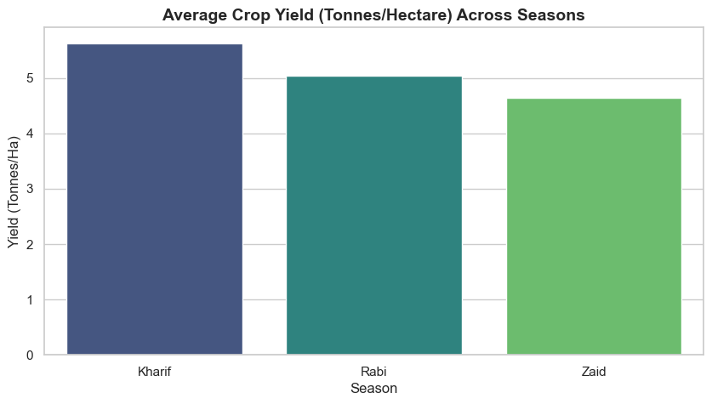
RESULTS: Yield & Profit Across Seasons
Kharif shows the highest average yield and profit; Zaid the lowest.

Slide 7
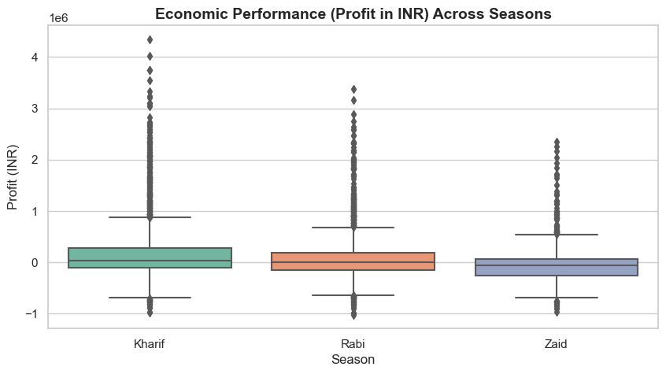
RESULTS: Yield & Profit Across Seasons
Kharif shows the highest average yield and profit; Zaid the lowest.

Slide 8
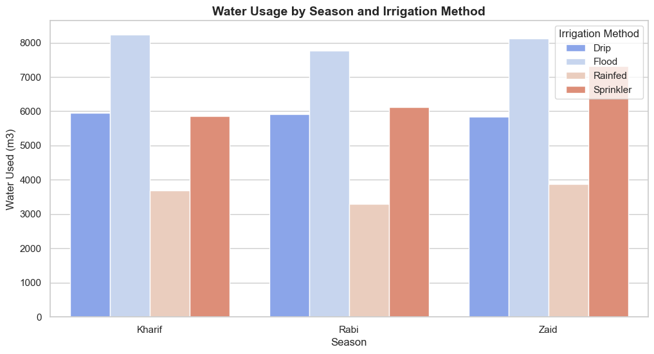
RESULTS: Water Usage by Season & Irrigation Method
Flood irrigation consumes the most water in every season; Rainfed is most water-efficient.

Slide 9
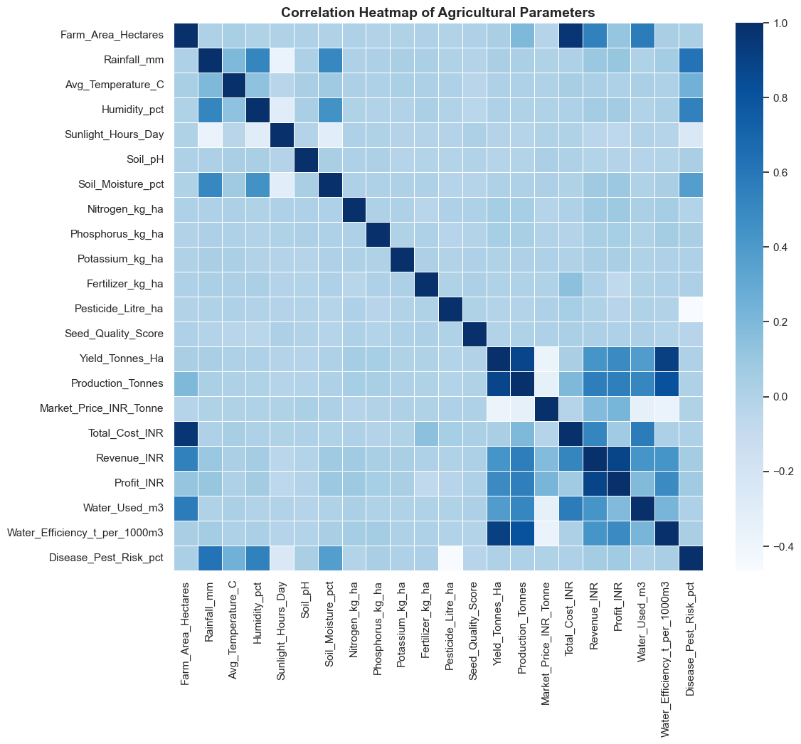
RESULTS : Correlation Heatmap of Agricultural Parameters
Yield, Production, Revenue, and Profit are strongly inter-correlated.

Slide 10
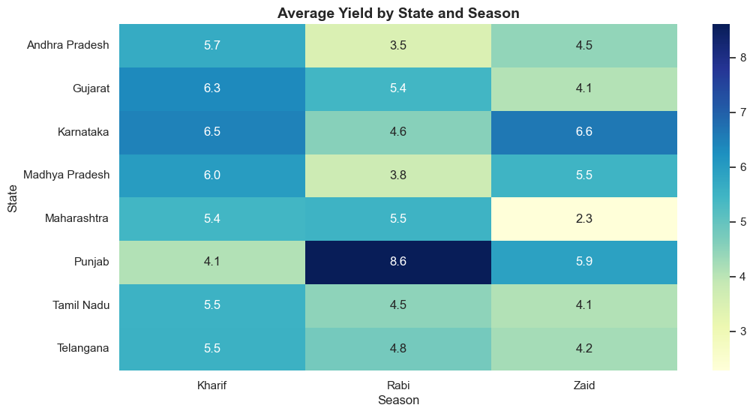
RESULTS: Regional & Crop-wise Yield Patterns
Punjab peaks in Rabi (exception to the general trend.

Slide 11
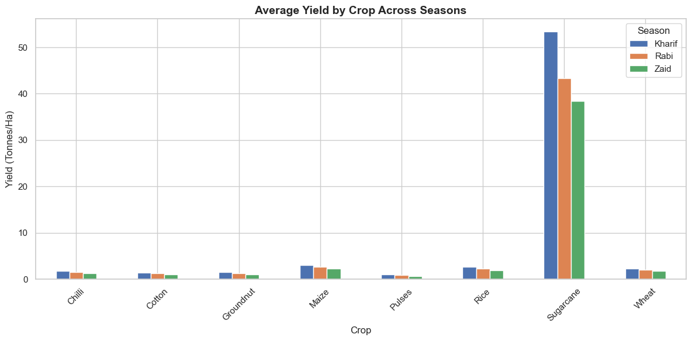
RESULTS: Regional & Crop-wise Yield Patterns
Sugarcane yields dwarf all other crops.

Slide 12
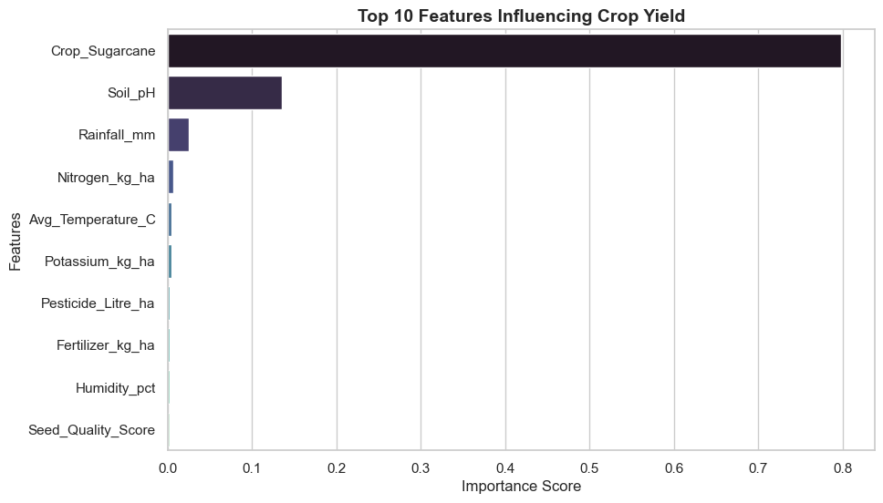
RESULTS: Model Performance & Feature Importance
Random Forest Regressor: R2 = 0.9623, RMSE = 2.70, MAE = 0.77

Slide 13
Future scope
• Integrate live weather and satellite rainfall data (via APIs) for real-time seasonal forecasting rather than historical averages alone.
• Deploy the yield-prediction model as a web dashboard so farmers/officials can get season-specific yield estimates for their state and crop.
• Extend the analysis to the district level for more granular, location-specific recommendations.
• Build a crop-recommendation system that suggests the most profitable crop for a given season, region, and soil condition.
• Apply time-series forecasting (e.g. ARIMA, Prophet) to project future seasonal trends using multi-year data.
• Incorporate market price forecasting to strengthen the economic/profit-side recommendations.

Slide 14
GitHub Link
https://github.com/PRABHASBHANUBOORA/Seasonal-Agriculture-Performance-Analysis
The above GitHub link consists of Agriculture Dataset, ipynb file of Seasonal Agriculture
Performance Analysis.

Slide 15
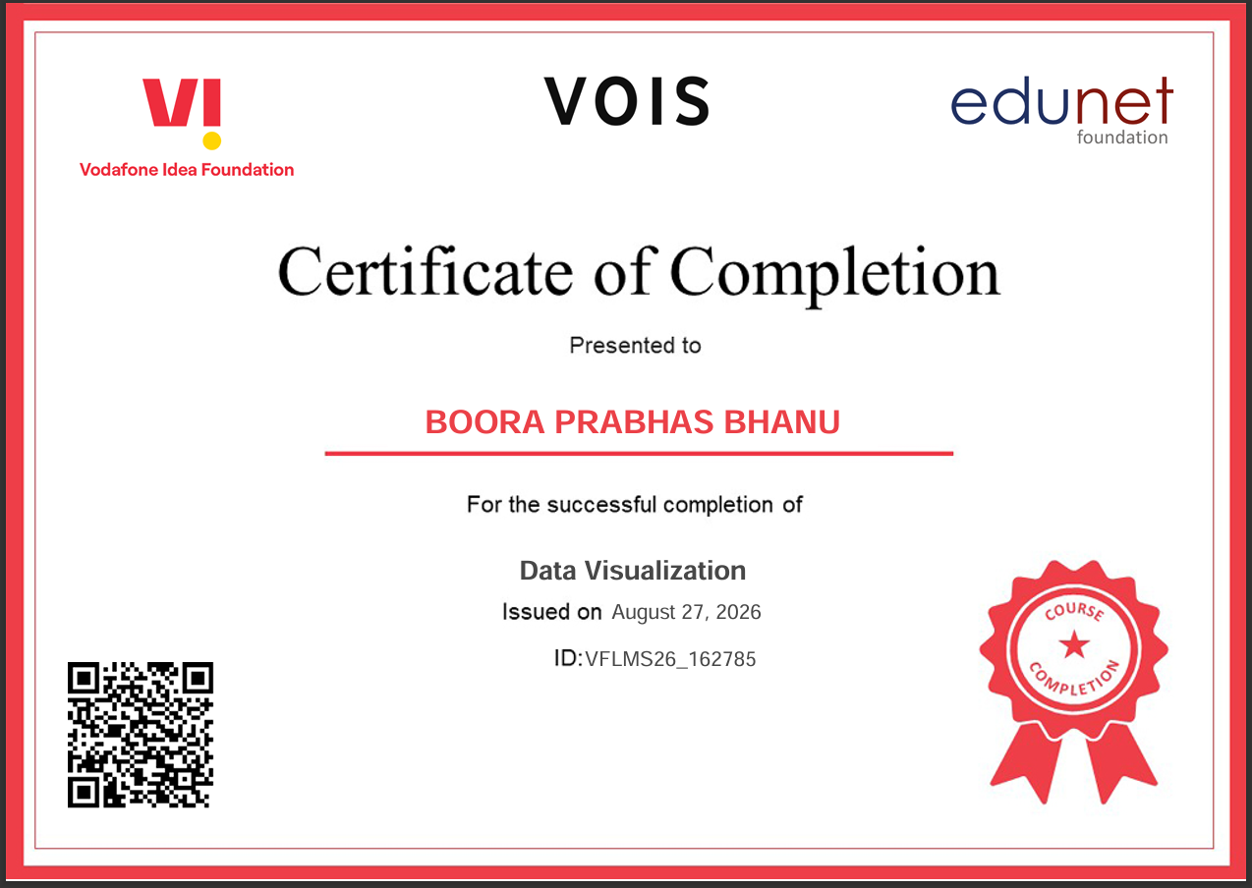
VOIS Course completion certificate -
Course name- Data Visualization

Slide 16
Thank you

